Slide 1




Electric Vehicle Sales Trends in India
This presentation analyzes Electric Vehicle (EV) sales trends across Indian states, providing insights for market planning, infrastructure investment, and policy development.
by Dhruv Singh
Notes:
1

Slide 2
Project Objectives
Identify Trends
Analyze Vehicle Categories
Predict Future Sales
Analyze EV sales trends across different states.
Explore popular vehicle categories and types.
Predict future EV sales using machine learning models.
Notes:
2

Slide 3

Tools & Technologies Used
Programming
Python
Libraries
Pandas, NumPy, Matplotlib, Seaborn, Scikit-learn
Data Analysis
SQL, Excel
Machine Learning
Random Forest Regressor
Notes:
3

Slide 4
Dataset Overview
1
State
2
Year & Month
3
Vehicle Type
Name of the state where sales occurred.
Date of sales.
2-Wheelers, 4-Wheelers, etc.
4
Vehicle Category
5
EV Sales Quantity
Passenger, Commercial, etc.
Number of EVs sold per state.
Notes:
4

Slide 5





Data Cleaning & Preprocessing Steps
Missing Values
Date Conversion
Encoding
Filled numerical data with median and categorical data with mode.
Converted date columns to proper DateTime format.
Encoded categorical variables for analysis.
Data Removal
Removed duplicates and unnecessary columns.
Notes:
5

Slide 6
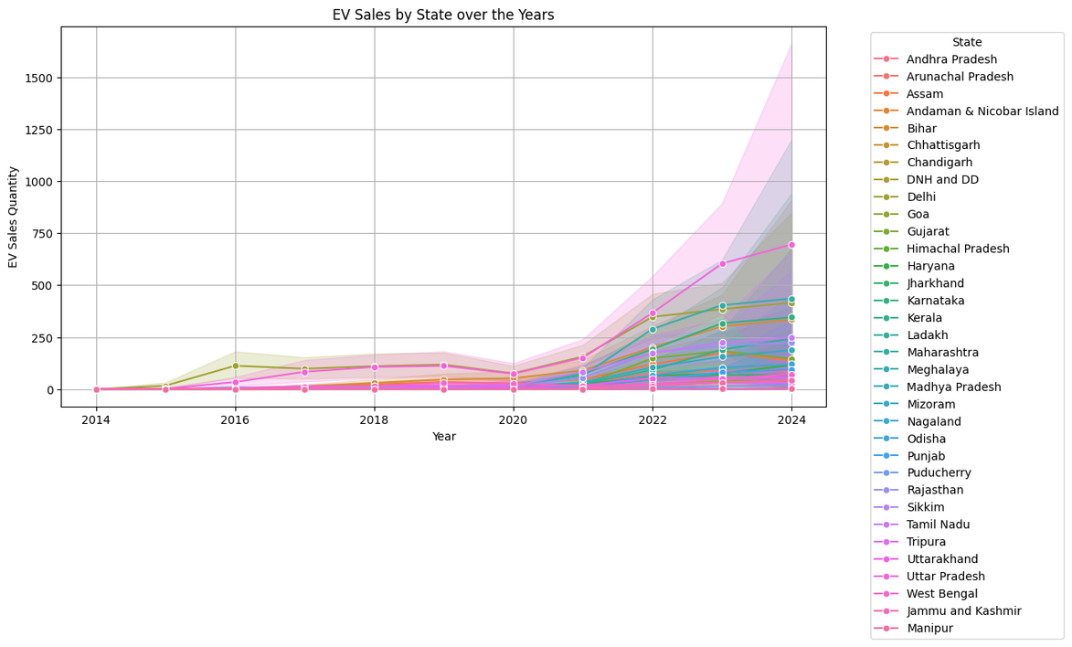
EV Sales Trends Over the Years
1
EV sales have been increasing significantly over the years.
2
Major growth observed after 2018 due to government incentives and rising demand.
3
Seasonal trends identified: Certain months show higher sales due to policy announcements.
Notes:
6

Slide 7
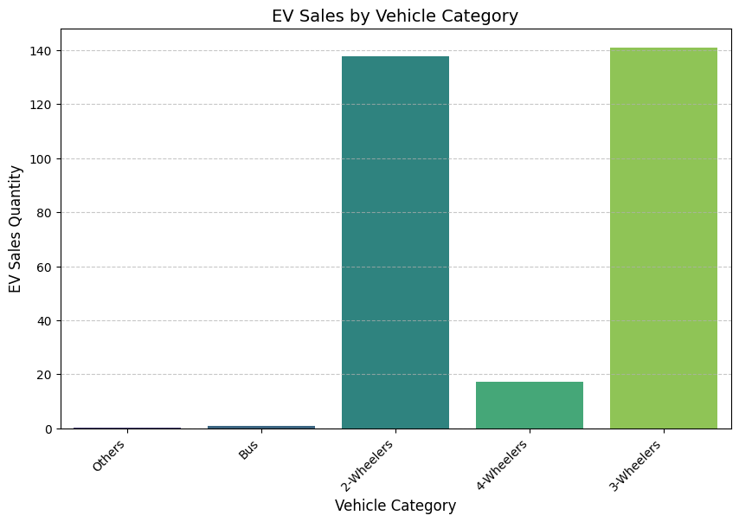
Sales By Vehicle Category
Key Insights :
Top States for EV Sales: Maharashtra, Karnataka, Uttar Pradesh, Gujarat.
Reason for high sales:
Government policies, infrastructure, and incentives.
Some states show lower adoption due to lack of infrastructure and incentives.
Notes:
6

Slide 8





Predictive Analysis (Machine Learning Model)
Model Selection
Used a Random Forest Regressor Model to predict EV sales.
Model Training
Trained the model using historical data and encoded categorical features.
Model Performance
Model achieved high accuracy in predicting sales trends.
Feature Importance
State and Vehicle Type were the most important factors in predicting EV sales.
Notes:
7

Slide 9
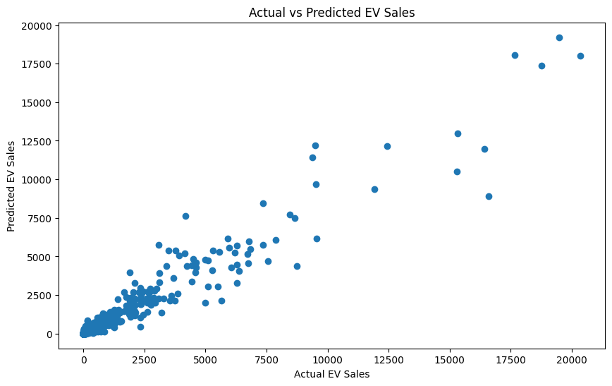
Actual vs Predicted EV Sales
Notes:
6

Slide 10
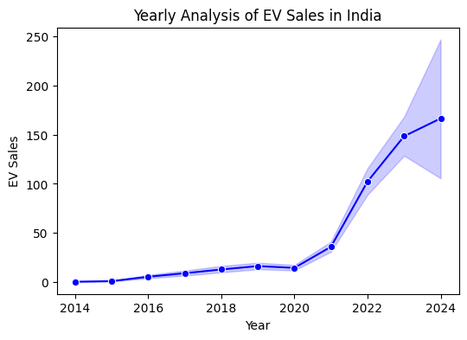
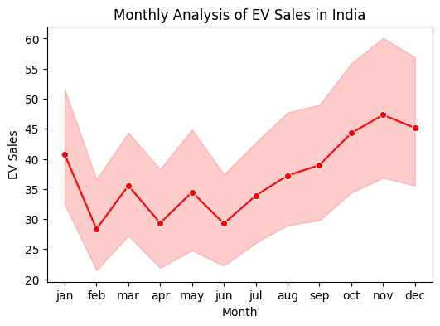
Monthly and Yearly EV Sales Analysis
Notes:
6

Slide 11
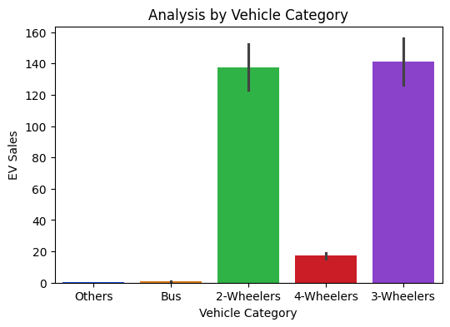
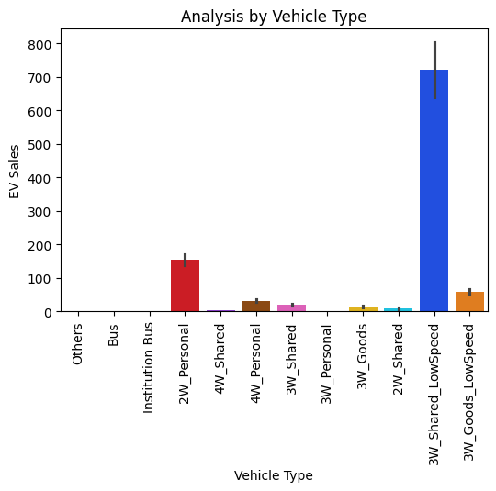
Analysis by Vehicle Category and Type
Notes:
6

Slide 12




Model Performance & Feature Importance
Prediction Accuracy
The model successfully predicts EV sales with reasonable accuracy.
Feature Importance
State and Vehicle Category have the highest impact.
Model Evaluation
Time-based Factors
Model evaluation using RMSE (Root Mean Squared Error).
Time-based factors (Year, Month) influence trends.
2
3
1
4
Notes:
8

Slide 13
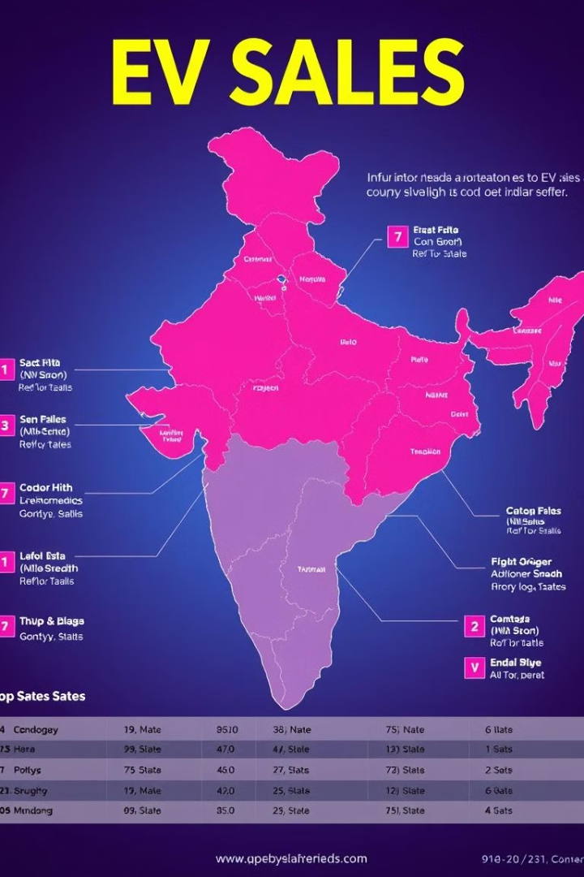
Summary of Insights
1
Top States
Maharashtra, Karnataka, and UP lead in EV sales.
2
Dominant Category
2-Wheelers dominate the market, followed by commercial 3-Wheelers.
3
Growth Post-2018
Sales have increased significantly post-2018 due to government incentives.
4
Predictive Modeling
Predictive modeling helps estimate future EV demand.
Notes:
9

Slide 14

Next Steps & Further Analysis
Enhance Model
Use Deep Learning for better prediction accuracy.
Include Macroeconomic Factors
Include macroeconomic factors (fuel prices, policies, etc.).
Expand Dataset
Expand dataset to recent years (2024 & beyond).
Real-time Data
Use real-time data to track ongoing EV sales trends.
Notes:
10

Slide 15


Slide 16

Contact ME
Email : ds075156@gmail.com
LinkedIn : https://www.linkedin.com/in/dhruvsingh-data-analyst/
GitHub : https://github.com/dhru07/Electric_Vehicle_Sales_Analysis_UM

